Slide 1
GYM APP
Redesign
Team members
Abdelrahman Khaled Aladawi c3
Mohamed Ali Eltokhy c4
Yousef Ahmed Alakraa c5

Slide 2

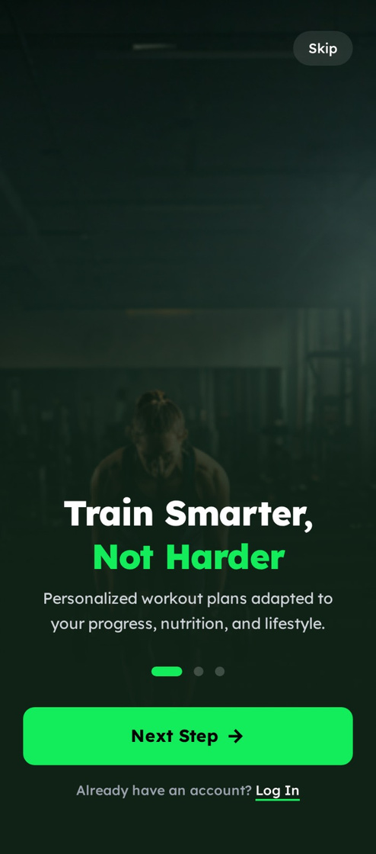
Onboarding Screen
UI Issues
  Too much text on a single screen (text overload)
  Strong background image reduces text readability
  Multiple CTA buttons with different colors → no consistency
  Weak visual hierarchy (no clear primary action)
UX Issues
  User is unsure what the first step should be
  Too many choices create cognitive overload
  Value proposition is not clear or concise

Slide 3
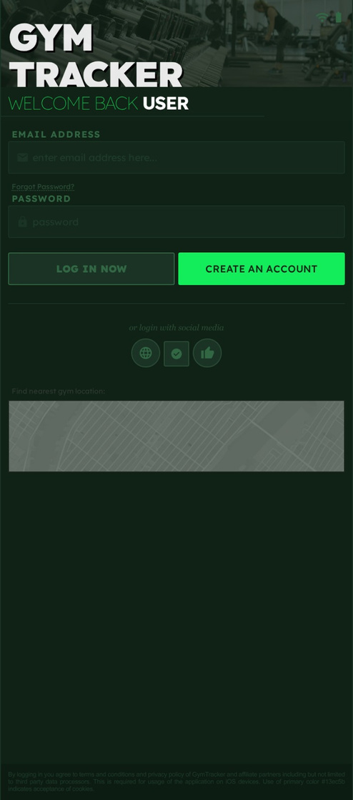
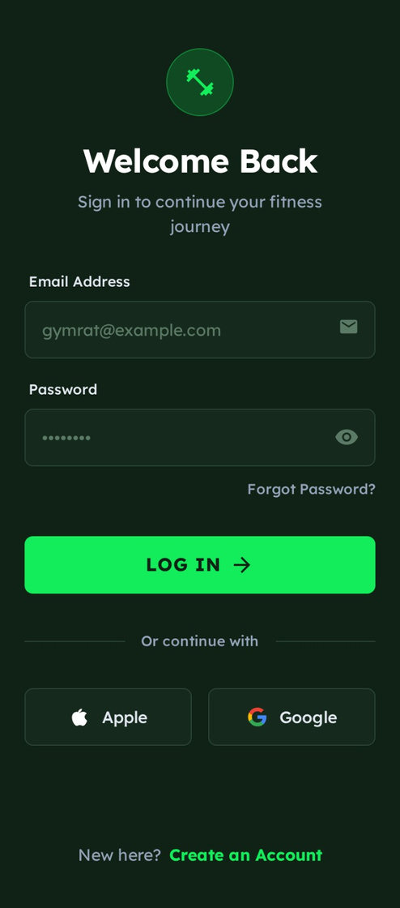
Login / Signup Screen
UI Issues
  Low contrast between background and input fields
  Input states (active / inactive) are unclear
  Buttons lack visual balance
  Typography is small and hard to read
UX Issues
  No clear visual feedback while typing
  Primary CTA (Login) does not stand out
  Login experience feels slow and unengaging

Slide 4
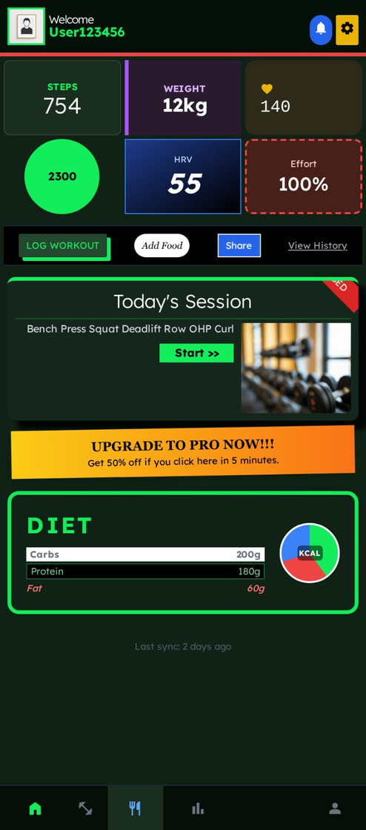
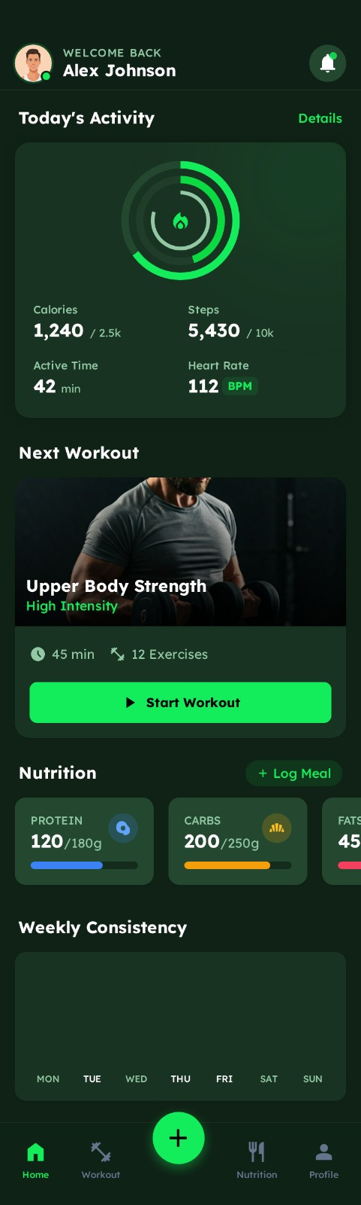
Home Dashboard
UI Issues
  Too many colors without a defined color system
  Inconsistent card sizes
  Overuse of borders and outlines
  Inconsistent icon styles
UX Issues
  No clear focus or priority for the user
  Primary action is not obvious
  Important information is buried in visual noise

Slide 5
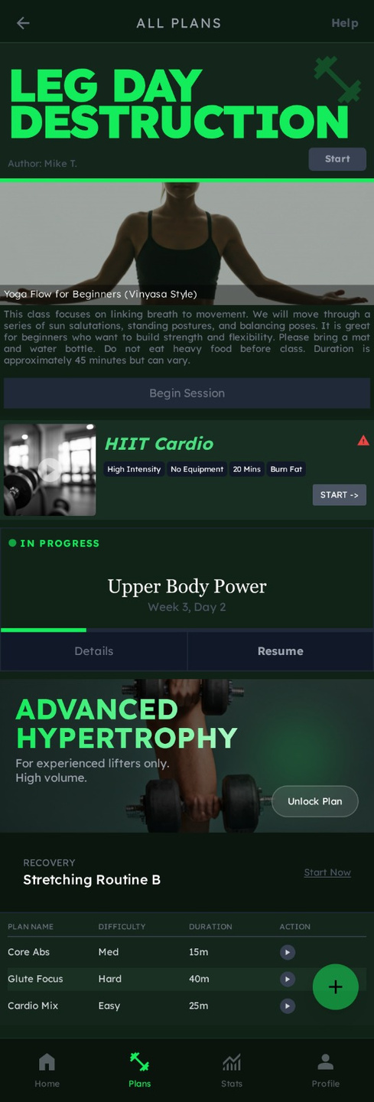
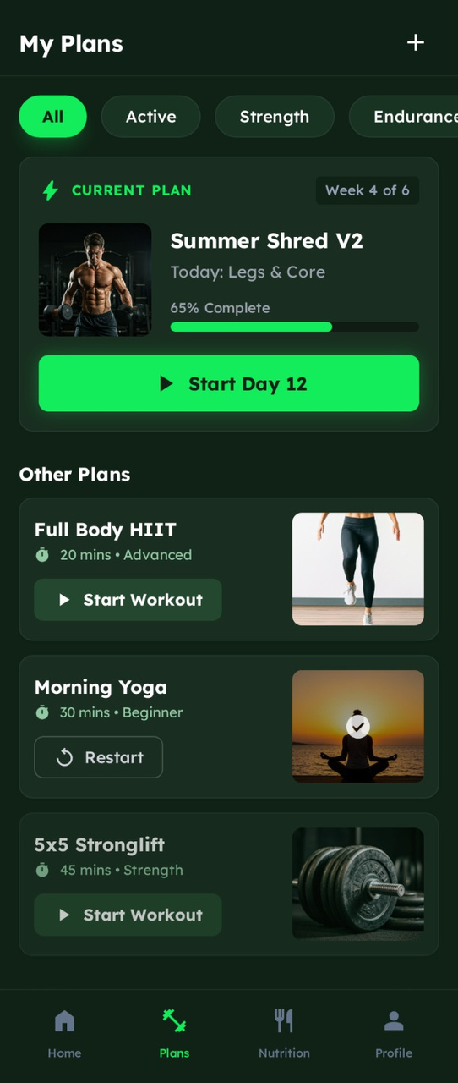
Workout Plans Screen
UI Issues
  Oversized titles dominating the layout
  Images used without clear hierarchy
  “Start” buttons are not visually prominent
  Poor spacing between elements
UX Issues
  Hard to identify the current active plan
  Lack of filtering or organization
  Users can feel lost between multiple plans

Slide 6
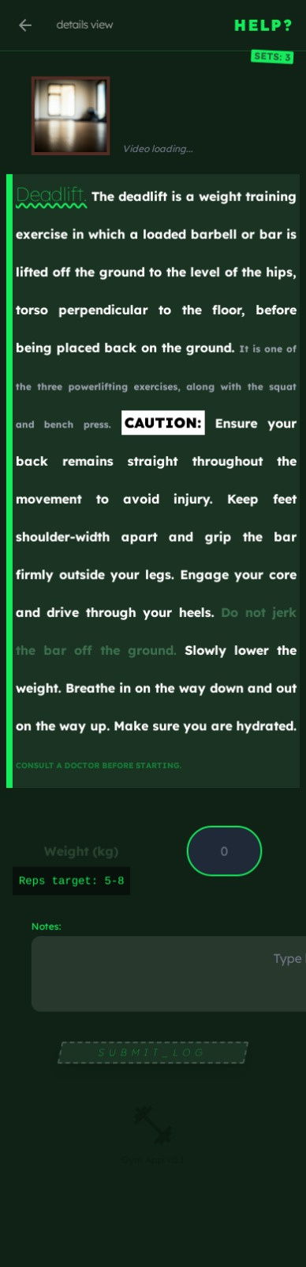
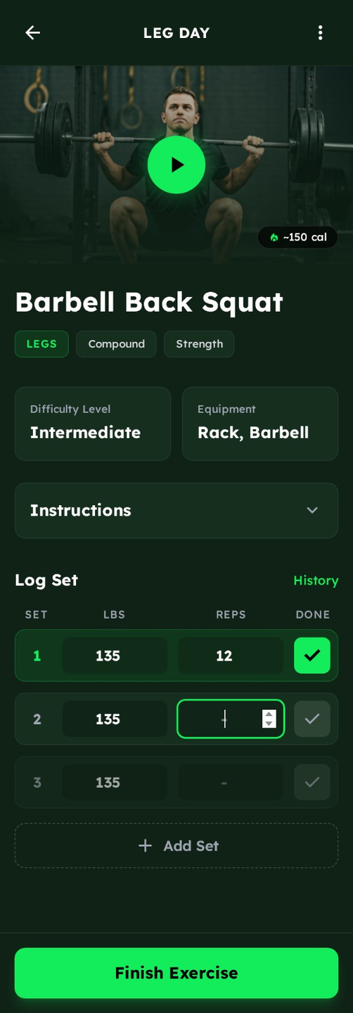
Exercise Details Screen
UI Issues
  Long blocks of text without proper sectioning
  Poor line height reduces readability
  Warning colors used excessively and inconsistently
  Main CTA (Finish / Submit) is not clearly visible
UX Issues
  Difficult to follow the exercise step by step
  No clear focus on the current action
  High mental effort required from the user

Slide 7
Thank you

